Slide 1
BASIC DETAILS
Institution: Panskura Banamali College
Department: Bachelor Of Computer
Application
Examination: B.Sc 6th End Semester Examination 2023
Paper Code: DSE4 (Discipline Specific Elective Paper)
Name Of Project: PepStudio (Over The Top Platform)
Genre: Android
Frontend & Backend: (FE: Xml, BE: Java, Cloud Firebase)
Used Software: Android Studio
Size: 17 Megabytes
Contributors:
Satyaki Chatterjee (Backend Dev.)
Roll No: 12161023 - 214078
Reg No: 2020PBC00079 (2020 - 21)
Binoy Kr Bar (Frontend Dev.)
Roll No: 12161023 - 214004
Reg No: 2019PBC00271 (2019 - 20)

Slide 2
What Is PepStudio And Behind Motivation
Introduction And Objective
PepStudio is a online OTT platform for streaming movies all around the globe. It is made for enhance the reach of film makers to the audiences in soft real time. You can watch movies that are made to stick to your mind. Watch the movies at highest resolution possible. You just need to make an account to access the app and you are just click away from the movies. You can create your account using your google, facebook or apple account or you can create by email id.
We are cinephiles. We are deeply exploring the cinema culture for many years and we realized that only making excellent cinemas is not enough to make a cinema successful. As Sir Satyajit Ray said producers also needs to take care of getting reach of as many people possible. Cinema Screens and Halls are playing the role for many decades. Later Television become a better bridge between creators and consumers of visual contents. But now times is far a head of those mediums. Internet connected peoples far beyond of unimaginable possibilities. By through this we can distribute much faster content globally. With this idea we are presenting to you the PepStudio, an over the top online platform. While we are talking about reaching to masses in india, we had to make an app that is compatible to all kind of devices. So we made it very lite and very less resource consuming. The whole app is only 17 megabytes. It puts very less pressure to the hardware.

Slide 3
Flow Of The Software
User Interaction
Is Logged in?
No
Login UI
Shows List Of Movies With Search Icon
Yes
Change Account
Tab 1
Fragment Of 3 Tabs
Tab 3
Profile Of User
Settings
On Click A Movie
Tab 2
Log Out
On Click A Movie
Movie Description With Play Button
Shows Libraries of To Watch, Favourite and Downloaded
List of Movie Cards With Play Button
On Click Play Button
On Click Play Button
Starts Playing The Movie
On Searching A Movie
User will firstly enter the app and will see a welcome page with a begin button then with a click, they will be redirected to the login page. If user is already signed in then a fragment of 3 tabs will open else they can sign in with one touch sign in of google, facebook and apple. In the fragment there will 3 tabs that is movie feed, library and profile. The movie feed will be the list of movies that are in the server and a search button to find with name. In the library fragment It will show three short list of movies that you are selected as to watch, favourite and downloaded for offline streaming. In the profile fragment, it will represent dp of user, name and email id with list 3 buttons i.e change account, settings, logout will works as the name suggests. By clicking on a movie it will redirected to a page of description of the movie(cast, year, story, director, poster, distributor, ratings, etc.

Slide 4
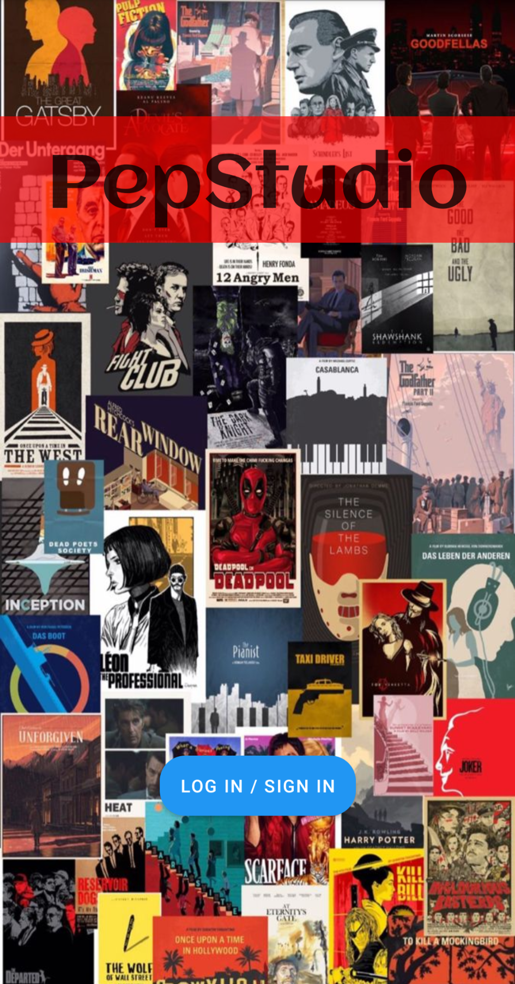
Welcome Page
First Page
Name Of The Application: one the middle top portion of the welcome page will be labeled with the name of PepStudio.
Background Wallpaper: The background will collaged posters of legendary movies to see before you die.
Getting Started Button: On the middle bilow of the welcome page that will show a capsule button will check if the user is already signed in or not. If not then it will redirect to the login page else it will redirect to the fragment activity.

Slide 5
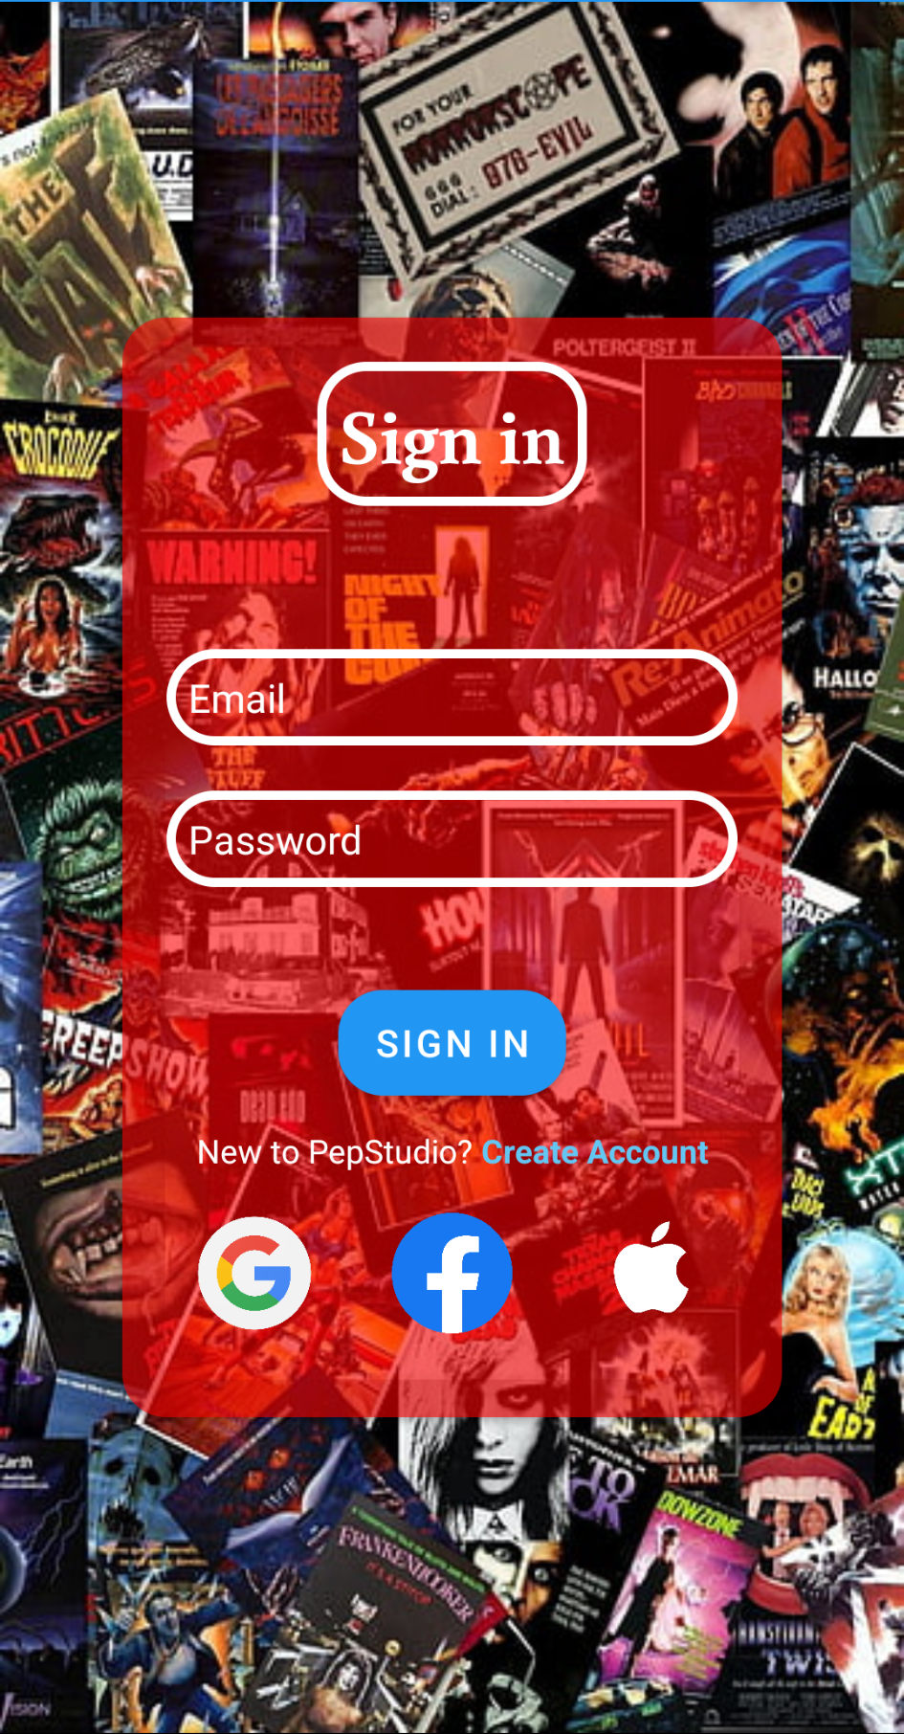
Login Page
The Authenticator
EditText For Credentials: If user want to login with their user id and password. Then they can enter them and can login button.
Sign In Button: Below of two field of credentials, there will be a login button that will work to check if the credentials are right and the account exist or not.
Login with other apps: If the the user wish to login with other than email and password then they can use their existing account to login like Google, Facebook, Apple accounts. They can click on the respective Image Button and can also click on the create account text. By these, the user will be redirected to the pages and popups of the SDK to choose their accounts to login.
Background WallPaper: The background of the page will be a random arrangement of movie posters and specifically the signin portion in the middle of the page is background with transparent red card.

Slide 6
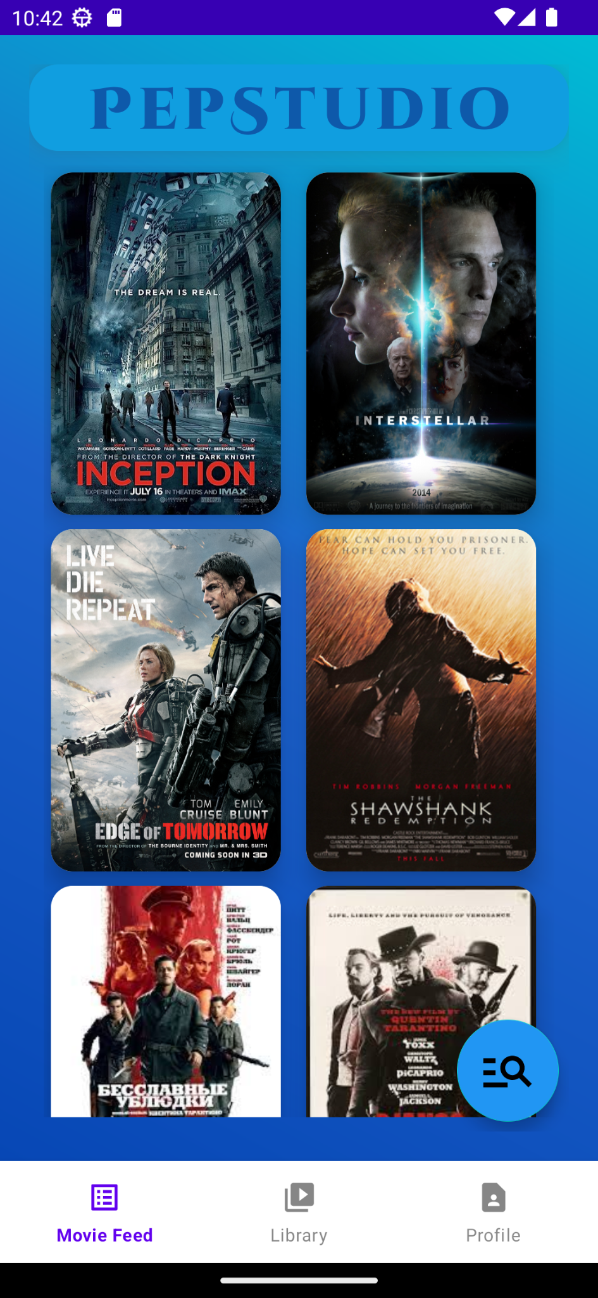
Insider (Movie Feed)
List Of Content
Header: The header of the page will be the name of application, background with a sky blue card.
Movie List: The page will mostly acquired with the list of movies that are stored in the server. The movies are represented with the miniature posters of the movies. The user have to scroll to discover new movies. The List of Movies are random.
Cards Of Movies: Each card of movies is represented with the poster of the movie. If user want to know more about the movie then have to click on the poster.
Background: Background of the page will be the gradient of sky blue and sea blue color from top right corner to bottom left corner.
Search: On the bottom left of the page there will a floating action button that will be used to search movies with specific name or sub-name. That will collect and list the movies and show.

Slide 7
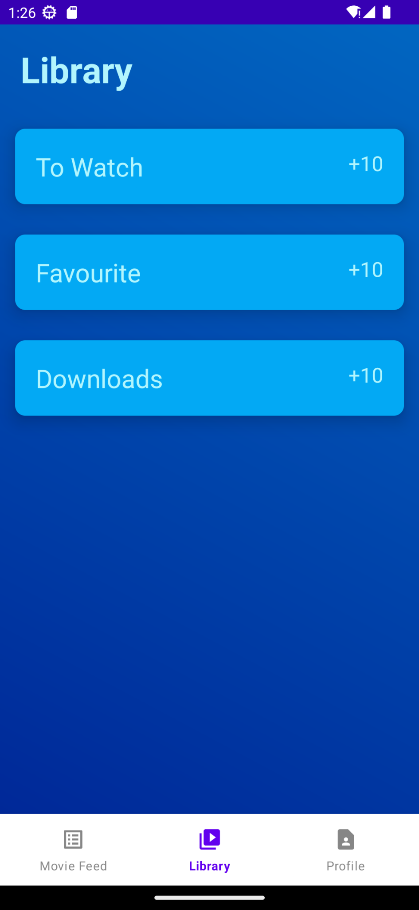
Insider (Library)
Preference Wise Lists
Header: As heading of this fragment there will be name of the fragment that is library fragment.
Lists: There are three lists in the library fragment that are To Watch, Favourite, Downloads.
To Watch: To Watch list will collect those movies that user have chosen to watch later.
Favourite: Favorite list will collect those movies that user have identified as loved.
Downloads: Downloads list will collect those movies that user had downloaded for offline streaming.
Background: Background color of the entire page is navy blue.

Slide 8
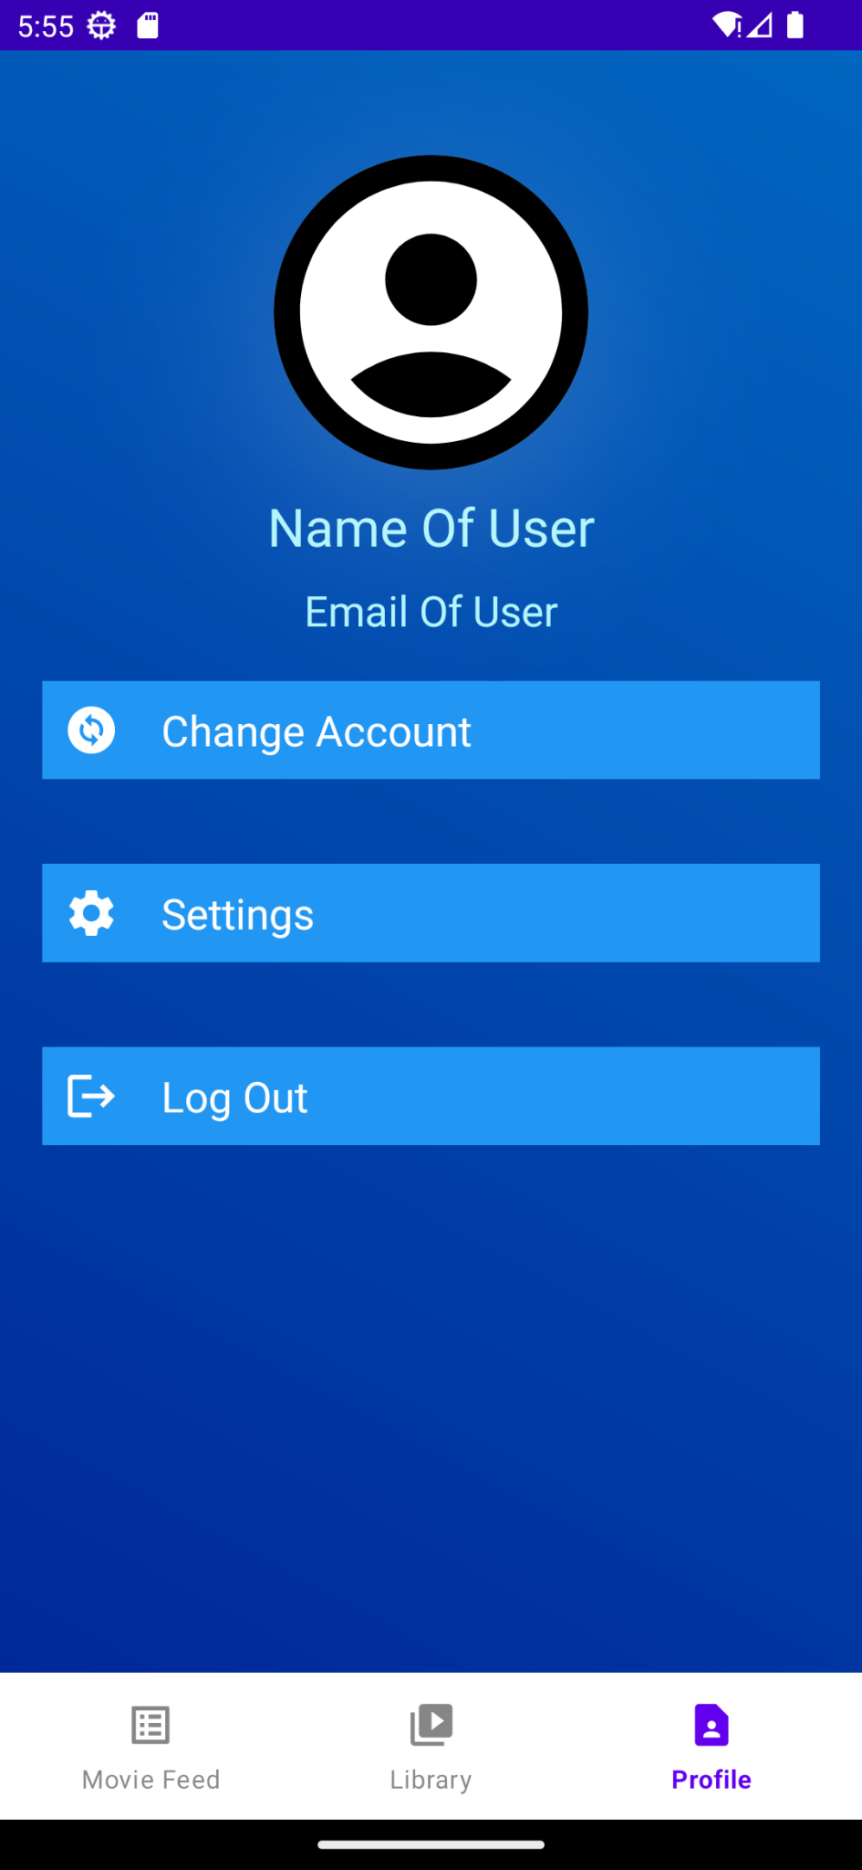
Insider (Profile)
User Details
Profile Picture: On the top middle of the fragment, there will be profile picture of the user, fetched from the authentication provider.
User’s Name And Email: Below of the profile picture there will be two lines containing name of the user and email address fetched from the authentication provider.
Change Account: Under email address there will be a button to change account that will change the account of the user. That will redirect the user to the login page.
Settings: Under the change account button there will be a button of settings.
Log Out: Below of the settings button there will be a logout button that will log out the user and take to relogin.
Background: Background color of the entire page is navy blue.

Slide 9
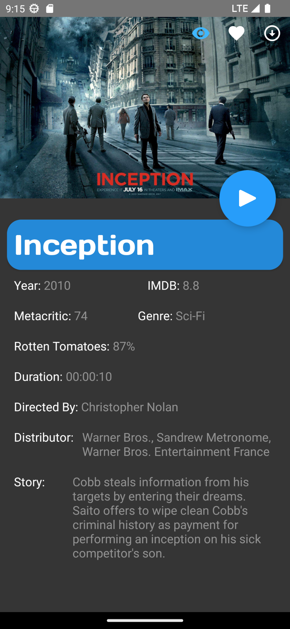
Movie Description
About The Movie
Shortlisting Buttons: On the top right corner there will be three buttons i.e to watch, favourite, download. By clicking those there will collect the movie to their list in library. After clicking they will be blue or white otherwise.
Poster: Top Of the page will be covered with a horizontal poster of the movie.
Play Button: In between lower body and poster there will be floating action button on the right side, that is play button. By a click it will take to the movie player and plays the movie.
Movie Name: On the bottom of the poster there will be a label that will be the name of movie with a blue background.
Details: Below of movie name there will be a scrollable section of movie details, containing year, ratings, duration, director, distributor, story, cast, etc. with transparent background.
Background: Background color of the page will be ashy dark.

Slide 10
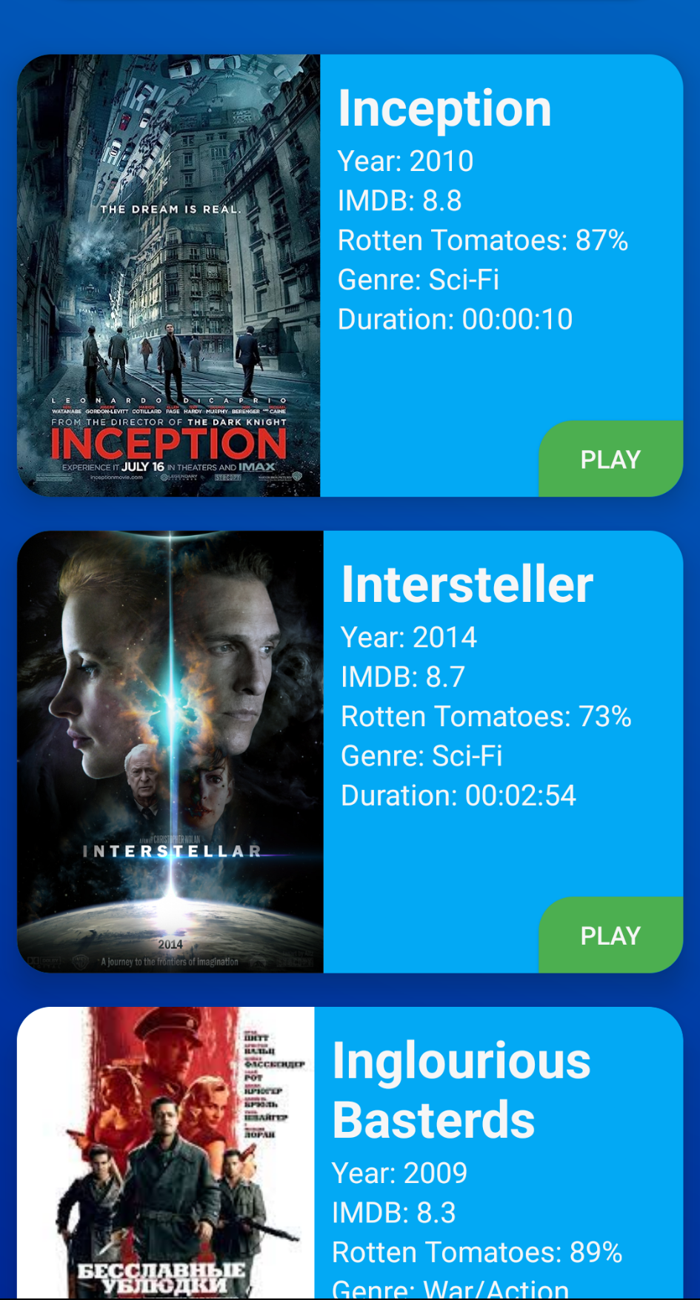
Collection
Filtered Movies List
In all four scenarios (searching, to watch library, favourite library, downloads), the layout will be the same structured as shown below.
Cards Of Movie: On each filtration, the collected movies will be shown as card. Half left of the card will be poster of the movie and other half will be few info about movie(i.e. Year, IMDB, Rotten Tomatoes, Genre, Duration) and a play button in bottom right corner.
Play Button: In between lower body and poster there will be floating action button on the right side, that is play button. By a click it will take to the movie player and plays the movie.
Background: Background color of the entire page is navy blue.

Slide 11
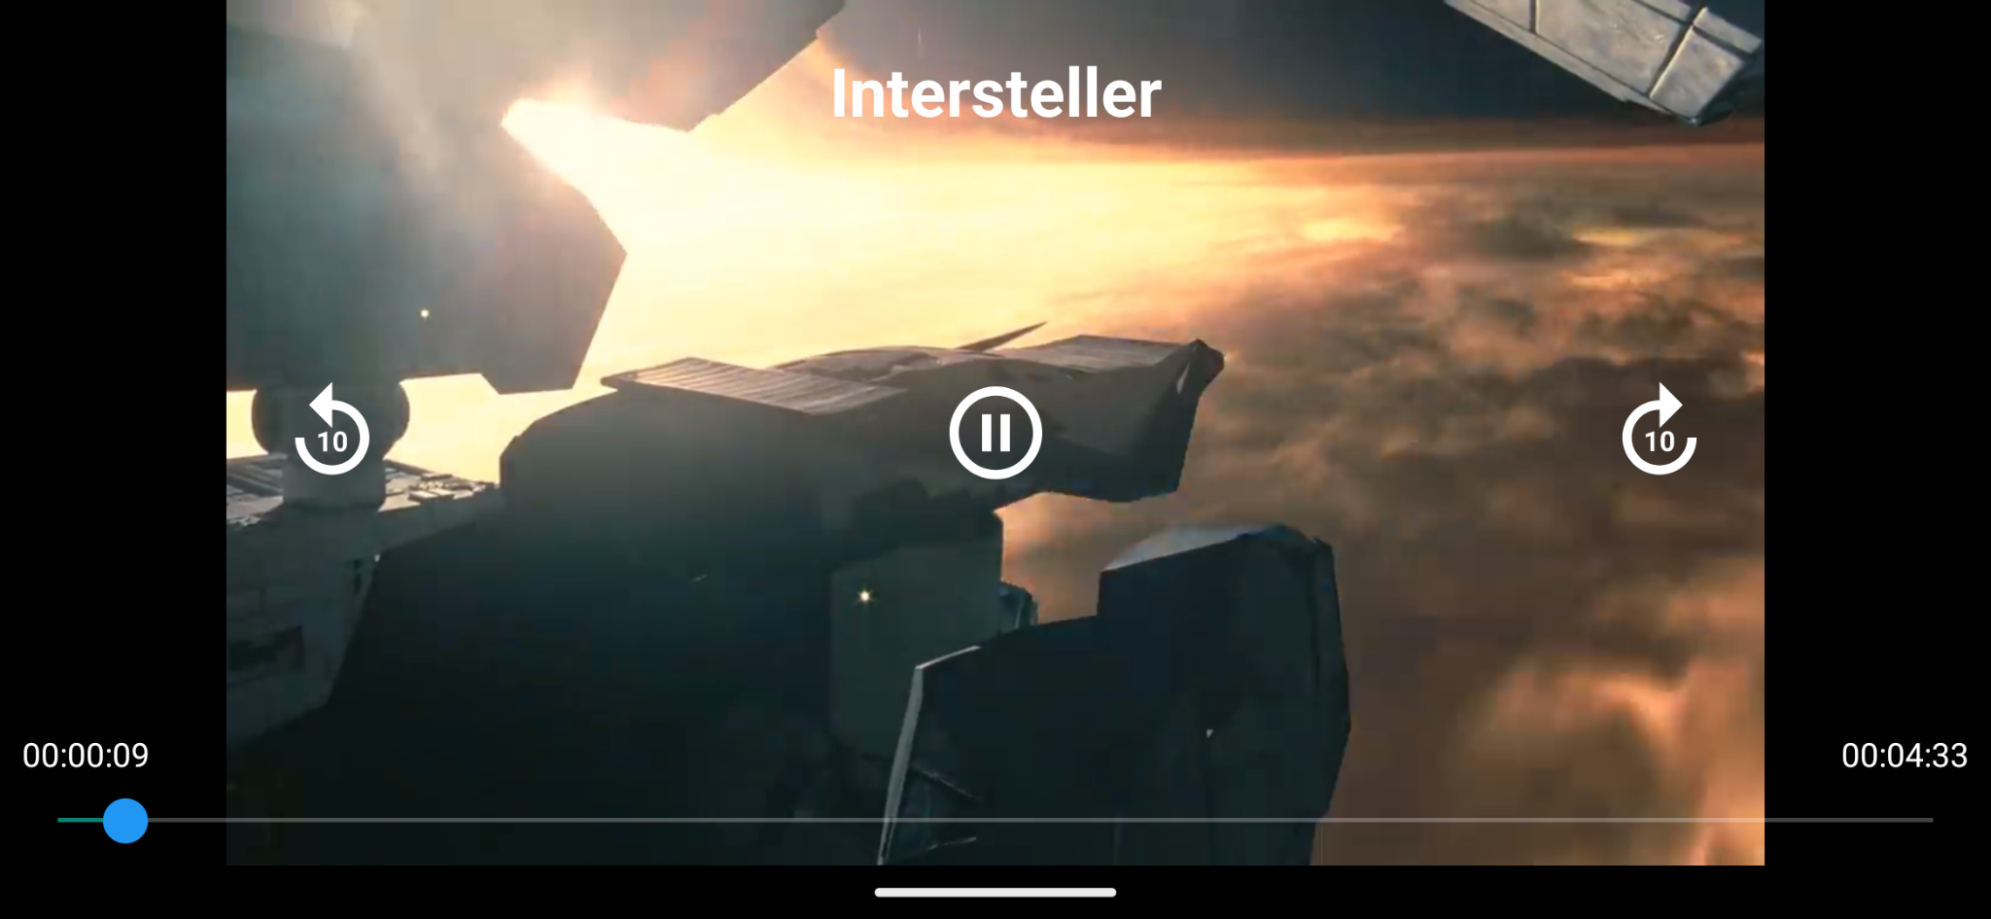
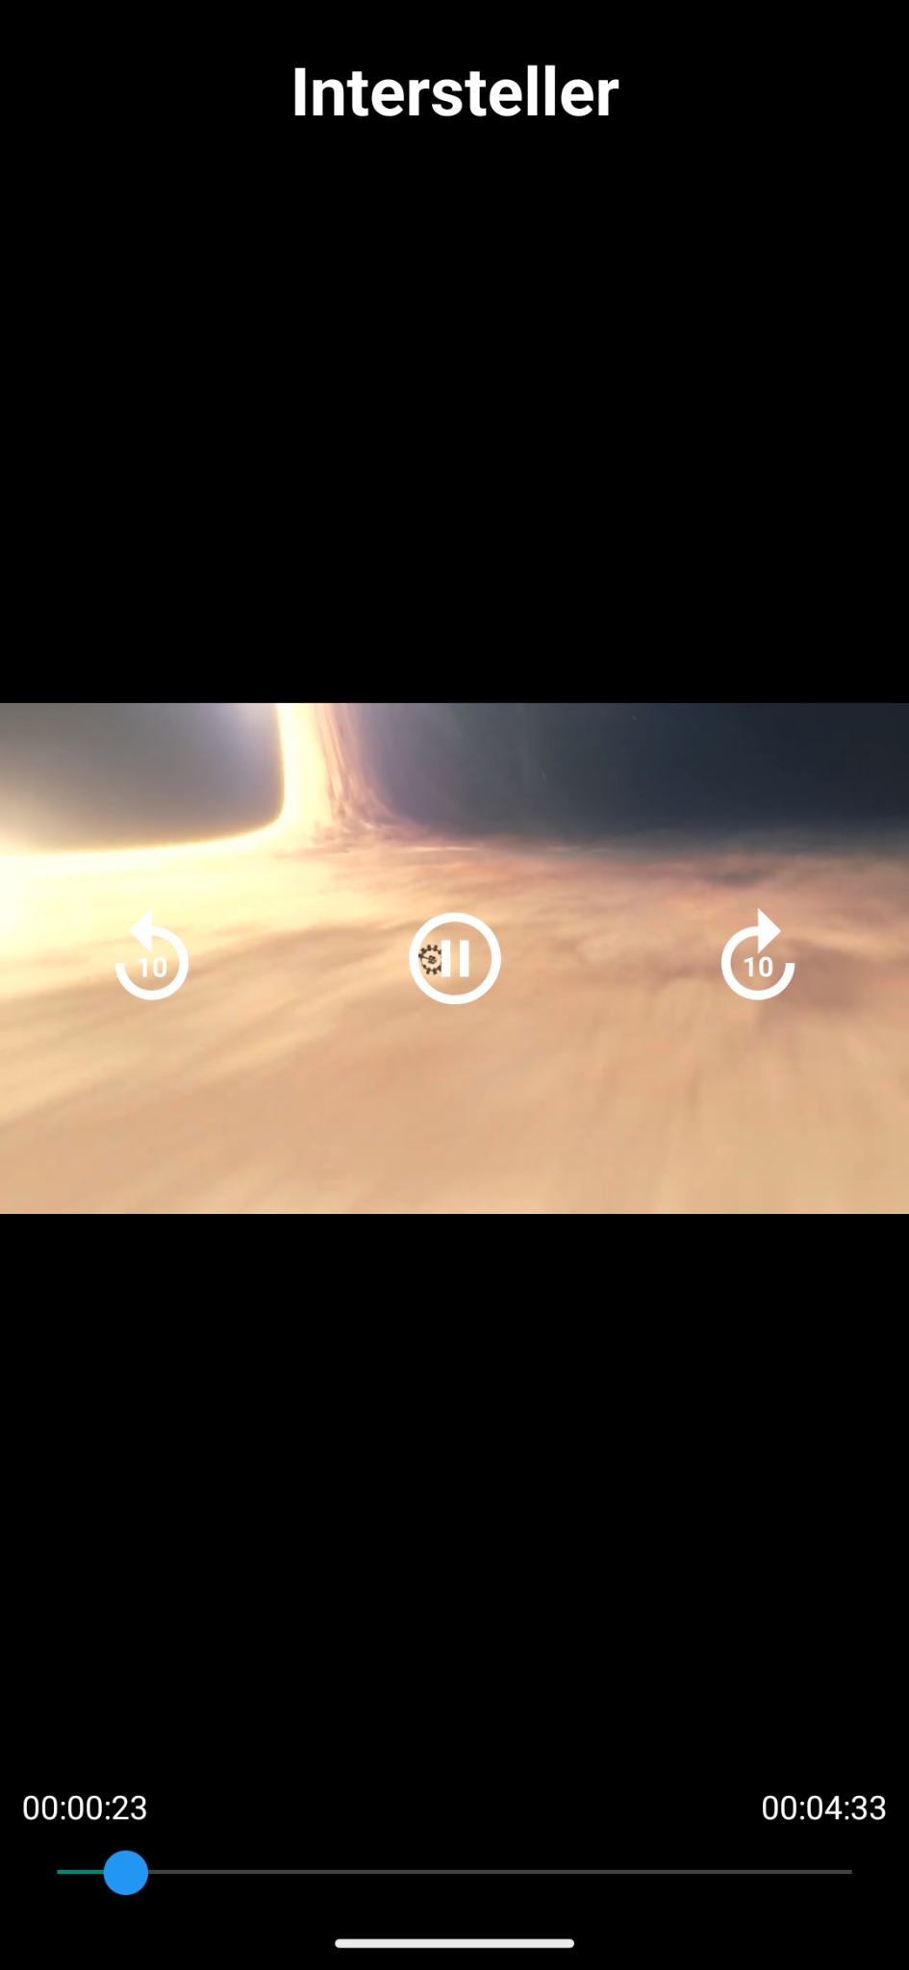
Movie Player
Movie Player
Header: On the top of the payer interface there will be name of the movie. It will be in white.
10 Sec Jumper: Beside the pause play button there will be two button to jump ten second forward and backward on right and left respectively.
Play & Pause Button: On the exact middle of the page there will be a play-pause button that will stop the movie and play according to the user. It will change symbol according to the current state.
Seekbar And Duration Reminder: On the bottom, along left to right, there will be a seekbar used to seek video in various time stemp and on the left, right end of seekbar will show current duration and total duration respectively.

Slide 12

Backend Description
Java Classes
Main Activity
First starts with main activity where we check that if the user is signed in or not. If the user is signed in already then with an explicit intent it will go to the fragment activity else it will arrive to the login activity.
Used Functions: onCreate(), onClickListener(), setContextView(), GoogleSignIn.getLastSignedInAccount(), startActivity().
Login Activity
In the login activity there are four kinds of authenticator those are Google Sign In, Facebook Sign In, Apple Sign In and Sign In with Email & Password. In this we will authenticate the user with their chosen way or create a new account.
Used Functions: inRecord(), validation(), onClickListener(), onCreate(), setContextView(), FirebaseAuth function set, Facebook Login API function set, startActivity().
Fragment Activity
After that in fragment activity, there are three tabs those are movie feed, library and profile. Those are navigated with bottom navigation bar. Whenever user clicks any tab in navigation menu then it will replace the fragment with new instance of the chosen fragment. By default the first fragment is movie feed.
Used Functions: onItemClickListener(), replaceFragment(), SharedPreferences function set, Gson function set, FragmentManager Function set, Fragment Transition function set..
Movie Feed
The movie feed fragment is a view group of recycler view of span 2. The recycler view is 2 grid view of card layout. The cards will be loaded with movie objects. The Movie class is a blueprint of each movies. To load the card layouts into the recyclerview, we overridden the recyclerview adapter.
User Functions: Fragment initialization function set, onCreate(), onCreateView(), View Inflater function set, startActivity(), onClickListener().

Slide 13
Library Activity
In library feed is a gateway to three activity. Those activity collect three list those are made up by user. This is named Movie Library. This is also a fragment. Whenever a user clicks on a activity it opens it with explicit intent.
Used Functions: Fragment initialization function set, onCreate(), onCreateView(), onClickListener(), Intent function set.
Profile Activity
This is the last fragment among the three tabs. This is made of user’s profile picture, name email address. Below of that there are three buttons for the user i.e. change account, settings and logout. On click change account, it explicitly intent to login activity and on log out, it gets the current signed in user and sign it out. After Finish, it restart the app. This is named Profile Fragment.
Used Functions: onClickListener(), Fragment initialization function set, onCreate(), onCreateView(), onClickListener(), Intent function set, GoogleSignInAccount function set.
Movie List Adapter / Search List Adapter
This very crucial class in the software. It is a custom recyclerview adapter. By default in packages there is already a recyclerview adapter but for primitive data types. While we are using a customised data type(Movies.java), we had to override the adapter class and it’s functions. It binds every card with it respective movies instance.
Used Functions: onCreateViewHolder(), onBindViewHolder(), onClickListener(), viewHolder.class, getItemcount().
Video Downloader
It is a java class used to download and fetch from the database needful videos and photos.
Used Functions: Not Discloseable.
Video Player Activity
This activity is responsible for playing a video from the server or secondary storage. It is linked with a VideoView layout. It plays the movie from path or link. The video player is integrated with a seekbar and durations by which user can jump on any timestamp. It also had 10 sec jumping switch and play pause switch.
Used Function: sethadler(), Handler function set, Runnable function set, timerstring(), initializeseekbar(), onClickListener(), onReadyListener().

Slide 14
Main Activity
Shows Welcome Page To The User
Login Activity
Checks If User Is logged In.
Logs User In
Create Account
Fragment Activity
Initialize Collection Of Movies
Replace Fragments
Passes Collection Of Movies
Movie List Adapter / Search List Adapter
Binds Movie Object With Recyclerview
Profile Activity
Represents The User
Movie Feed
Represents Movie List
Library Feed
Represents Shortlisted Movies
To Watch
Collect Movies To Watch Later
Movie Description
Shows Details About The Movie
Downloads
Collect Downloaded Movies
Favourites
Collect Movies Marked As Favourite
Video Downloader
Downloads Movies
Video Player
Plays Movie For The User

Slide 15

Database Description
Google Firebase
Basic Structure Of Data Structure(JSON Tree)
Cast
1
Director
2
Distributor
Database Root
Movies
Genre
3
Database Root: Database root is a reference to the database, like a link that helps to embed database with backend of the software. Here our database is located in south-asia, Singapur.
4
Metacritic
IMDB
Movie Name
Poster Horizontal
Movies: In json tree, movie object is a encapsulated set of movie objects. Here each object represent a movie. The keys of these object is serialized to access easily. These objects are called as data snapshots. The serial indices starts from 1 to the number of movies.
Poster Vertical
Rotten Tomatoes
Story
Movie Object: Movie object is a instance of a particular movie. Each object contains data about a particular movie. The informations are cast, director, distributor, genre, metacritic, imdb, movie name, horizontal poster, vertical poster, rotten tomatoes, story, video link, year.
VideoLink
Year
Cloud Storage
The structure of database is arranged as simulated in this document. The database we are using is a non relational database. It doesn't structure data in table but as json tree. So there is no concept of keys.

Slide 16

Database Dataflow
Integration With Backend
Android Device
Cloud Storage
Secondary Storage Manager
Cloud Manager
Realtime DB
Java Backend
Data Snapshots
Media File
Request Of Data Fetch
Data Type
Database Manager
Movie Object
Yes
Server Administrator
Justified By Rules
Dispose
No
When the app searches for data then first it finds the data as shared preferences in internal storage. If it don’t find anything then it fetches from the database and stores it in the internal storage as shared preferences. It is a app specific storage, means no one can access those things without the app and deleted after uninstallation. When it had to fetch data from cloud server, it sends a request to the server administrator. Then it checks if the ask is according to the rule. If no then it disposes the request else it checks the type of the requested data. If it is a media file then it sends the access token of the request to the cloud manager and it provides the media file. Else if it is movie object then it sends the attached key of the request to the database manager and it sends object of the key. At last the object or media file sent to the backend as data snapshot.

